Slide 1

Lecture 7： Bayes Filter Implementations: Discrete Filters: Histogram Filter Particle Filter Haoyao Chen
Chapter 4
School of Mechanical Engineering and Automation

Slide 2
 | KF/EKF, IF/EIF, UKF (Gaussian Filters) | Histogram/Particle Filter (Nonparametric Filters)
Representation | Moments Canonical Unscented Moments | Finite number of values : Finite state space Samples
Implementation | Gaussian Density | Complex density
Computation | Efficient | High complexity (How to improve)

Slide 3
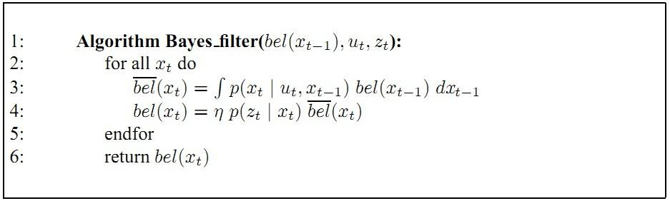
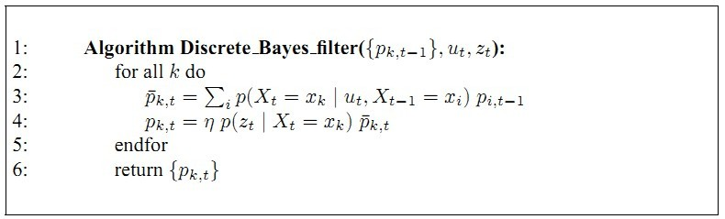
Discrete Bayes Filter

Slide 4
Discrete Bayes Filter Algorithm
Algorithm Discrete_Bayes_filter( Bel(x),d ):
η=0
If d is a perceptual data item z then
For all x do
For all x do
Else if d is an action data item u then
For all x do
Return Bel’(x)

Slide 5
Histogram Filter

Slide 6
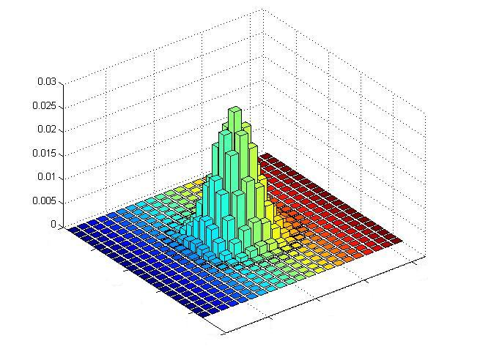
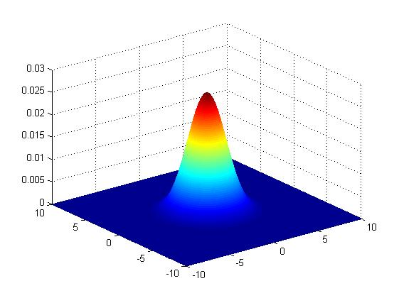
Discrete Distribution - Gaussian

Slide 7
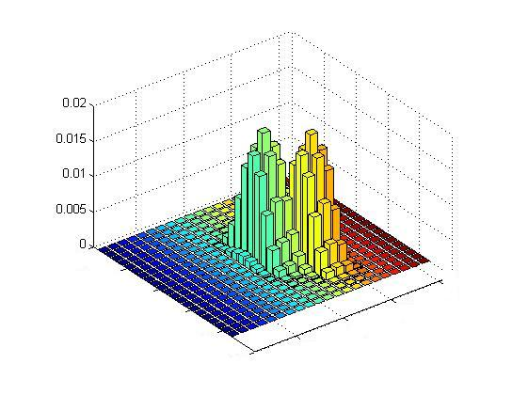
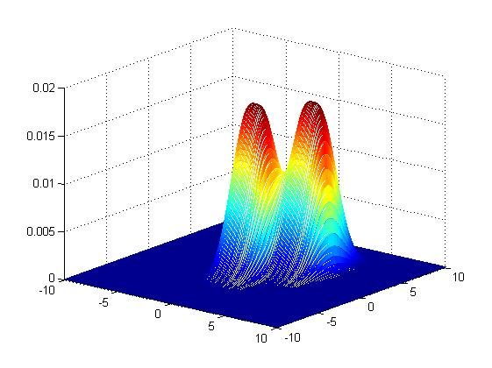
Discrete Distribution – Multi-model Gaussian

Slide 8
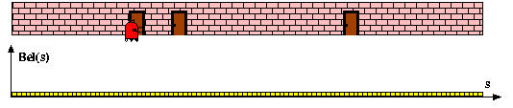
Piecewise Constant

Slide 9
Histogram Filter
Two questions:
How to calculate/represent the probability?
How to decompose the state space?

Slide 10
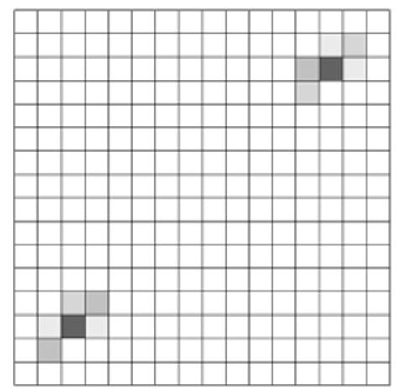
Bayes
?

Slide 12
Decomposition Techniques
Static
Dynamic

Slide 13
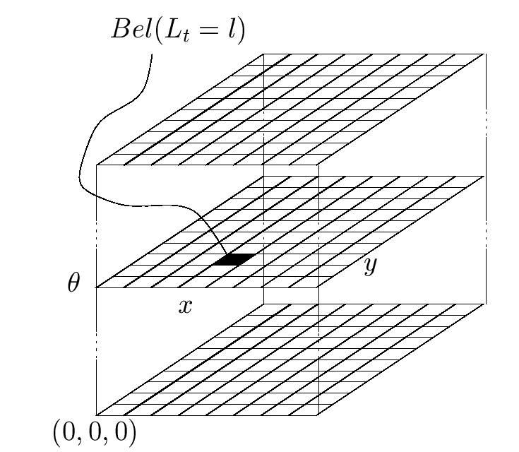
Piecewise Constant Representation
Static

Slide 14
Decomposition Techniques
Static
Dynamic: Density Tree & Selective updating

Slide 15
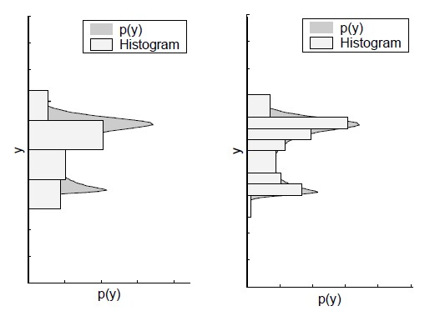
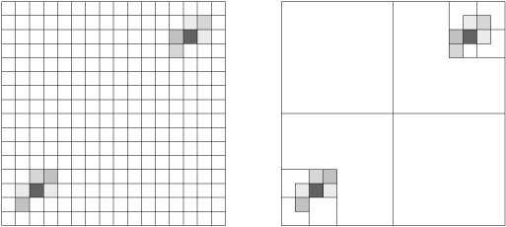
Tree-based Representation
Idea: Represent density using a variant of octrees

Slide 16
Selective updating

Slide 17
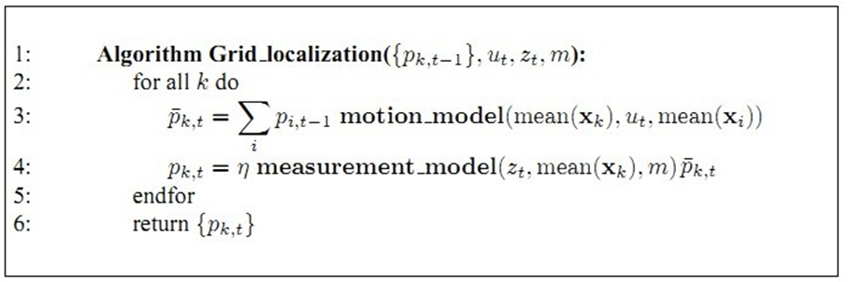
Application: Grid Localization
Global Localization

Slide 18
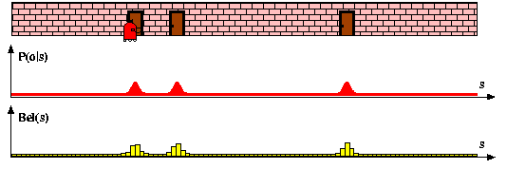
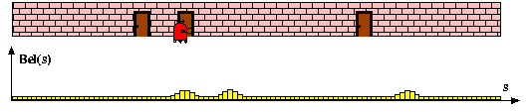
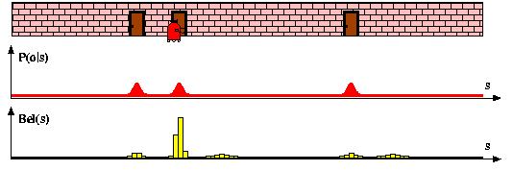
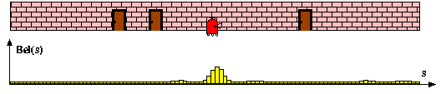
Measurement Model
Motion Model

Slide 19
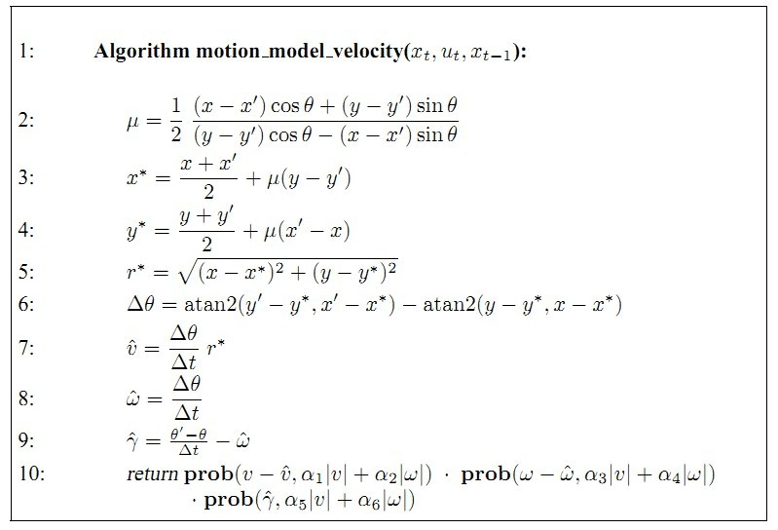
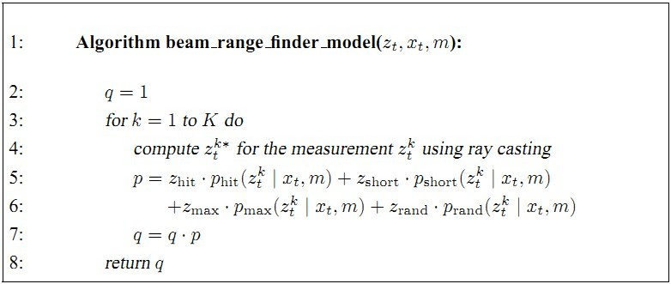
Application: Grid Localization
Plane Motion Localization

Slide 20
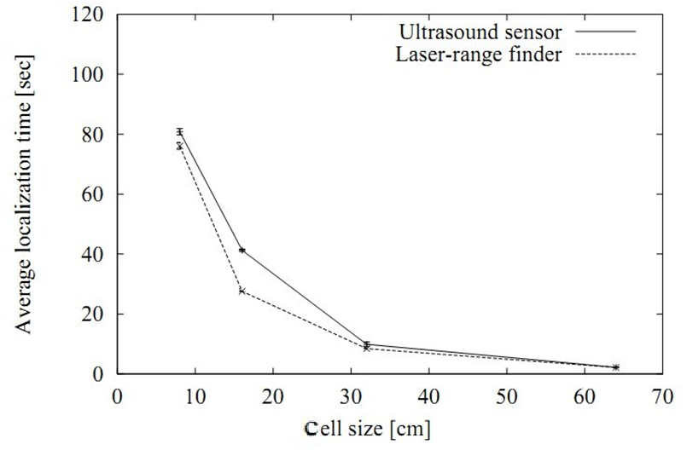
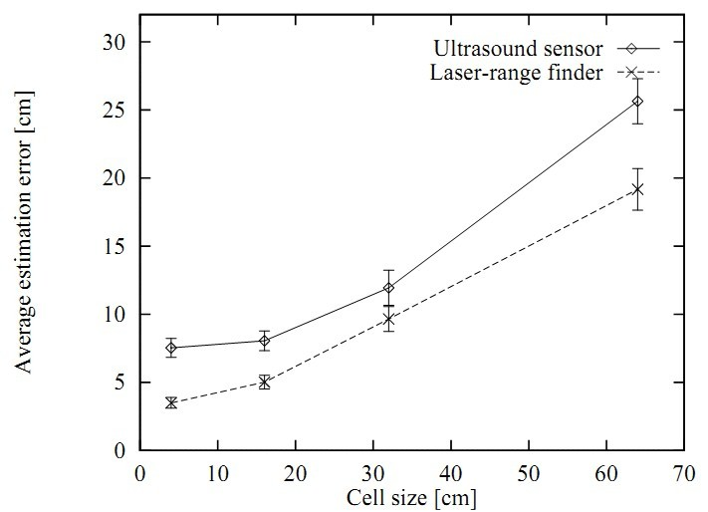
Problem derived from Grid Resolution

Slide 21
Problem derived from Grid Resolution
Sensor model (different even in a cell)
Motion model (Small motion, state not changed)
How to address these problems?
Inflate the sensor and motion model
E.g. enlarge the main Gaussian cone for range finder
random transition to a nearby cell

Slide 22
Computational Considerations
1. Model pre-caching: correct range table, sensor model table(with fine grained array of possible ranges);
2. Sensor subsampling
3. Delayed motion updates
4. Selective updating (when kidnapped problem?)
Very efficient

Slide 23
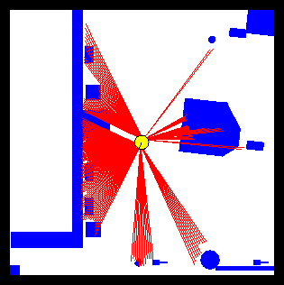
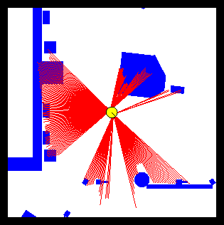
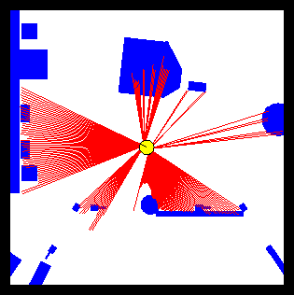
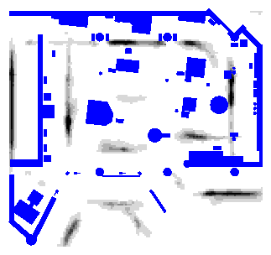
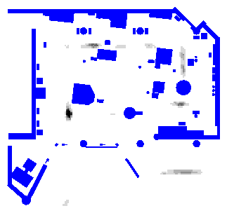
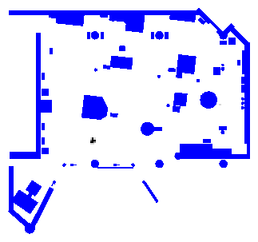
Grid Localization example:15cm, 5degrees

Slide 24
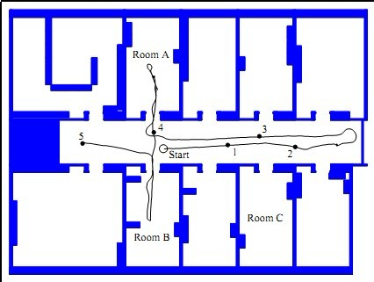
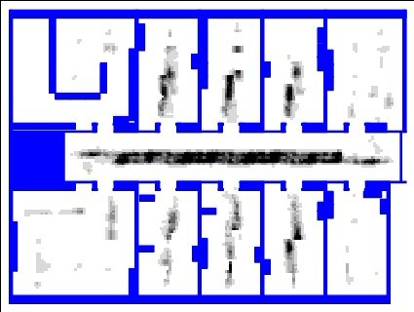
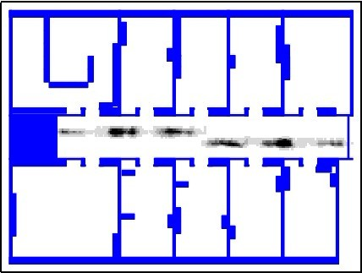
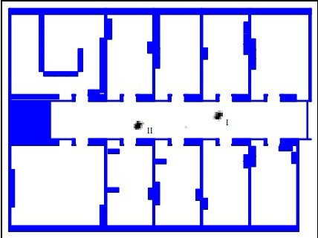
Grid Localization Example

Slide 25
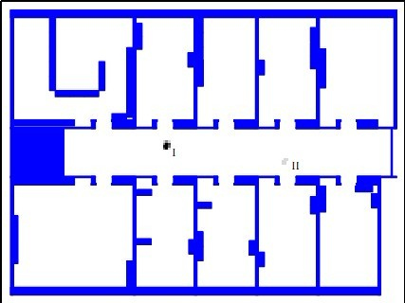
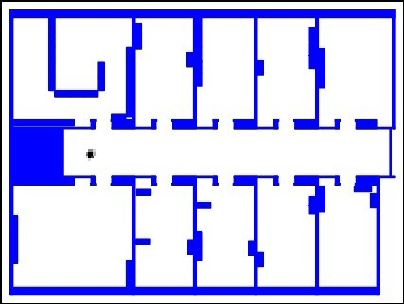

Slide 26
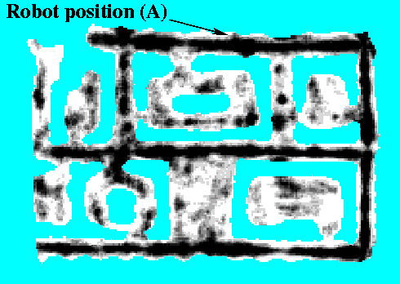
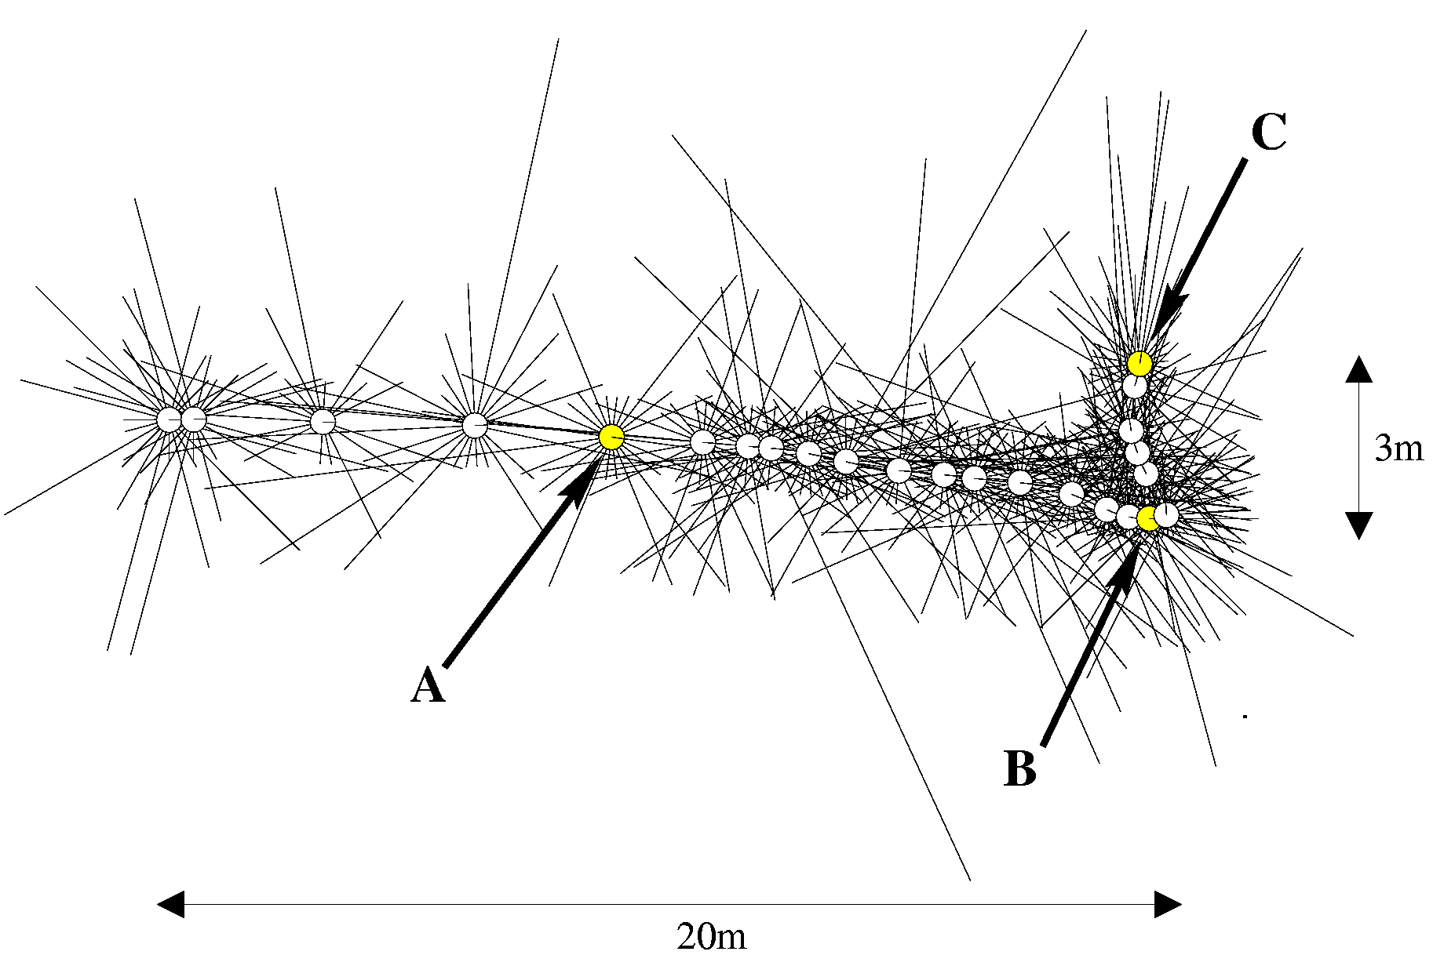
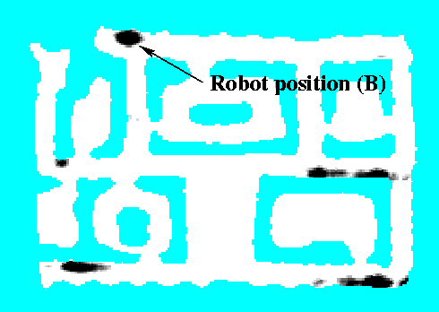

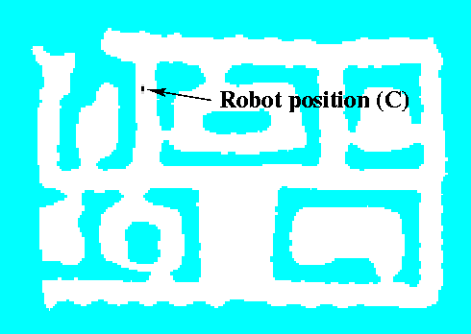
Sonars and Occupancy Grid Map

Slide 27
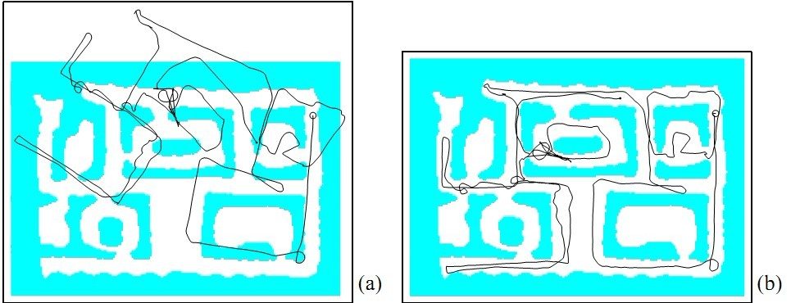
Sonars and Occupancy Grid Map

Slide 28
Particle Filter
Chapter 4

Slide 29
Particle Filters
Represent belief by random samples
Estimation of non-Gaussian, nonlinear processes
Monte Carlo filter, Survival of the fittest, Condensation, Bootstrap filter, Particle filter
Filtering: [Rubin, 88], [Gordon et al., 93], [Kitagawa 96]
Visual Tracking: [Isard and Blake 96, 98]
Dynamic Bayesian Networks: [Kanazawa et al., 95]

Slide 30
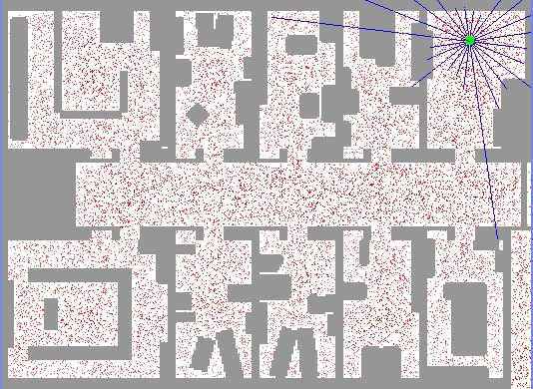
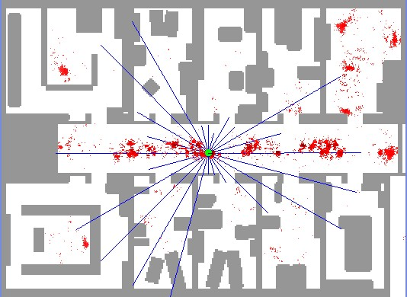
Samples(Particles)
Hypothesis as to what the ture world state may be at time t

Slide 31
Importance Sampling
Importance factor or weight

Slide 32
Importance Sampling
Discrete case:

Slide 33
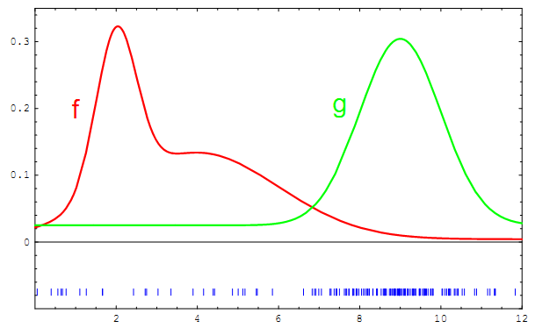
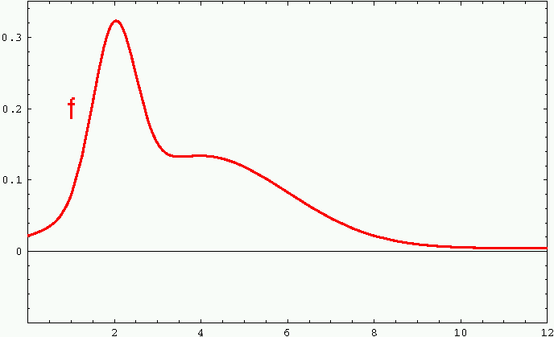
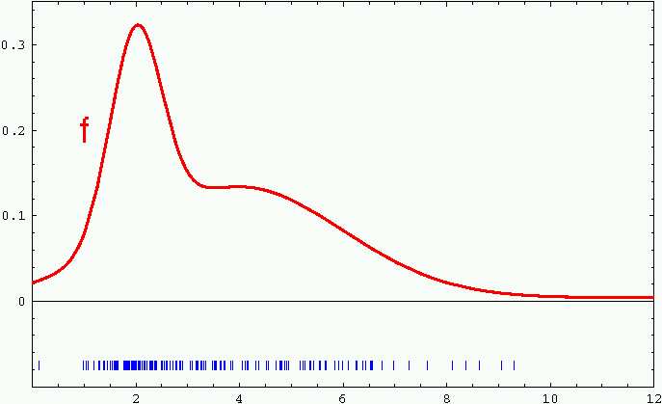
Sample-based Representation

Slide 34
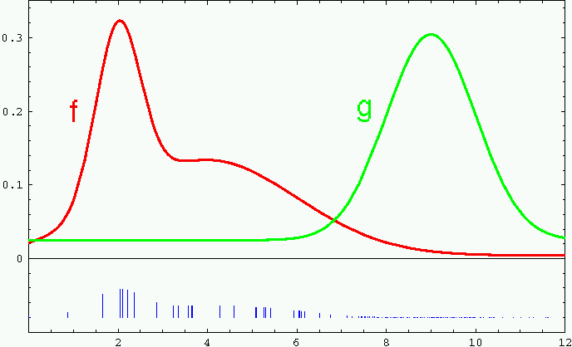
Importance Sampling
Weight samples: w = f / g

Slide 35
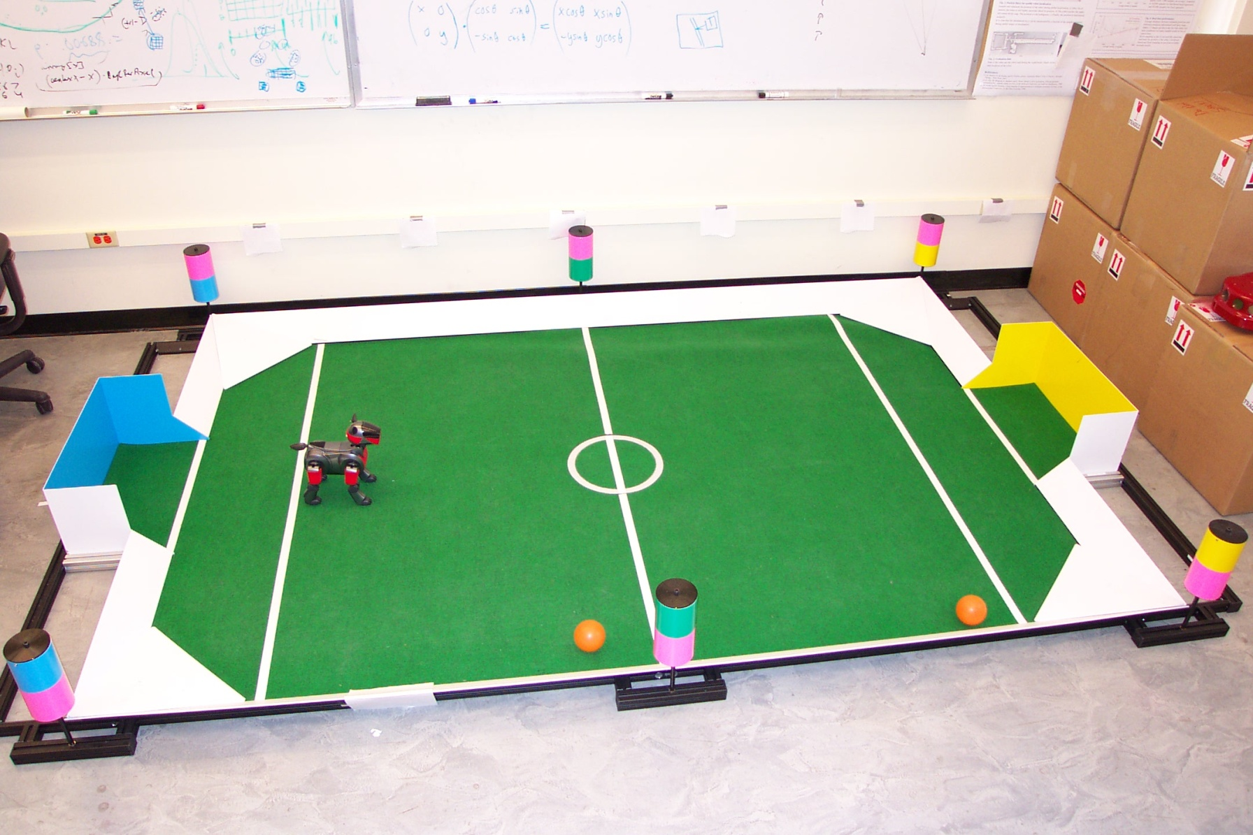
Importance Sampling with Resampling: Landmark Detection Example

Slide 36
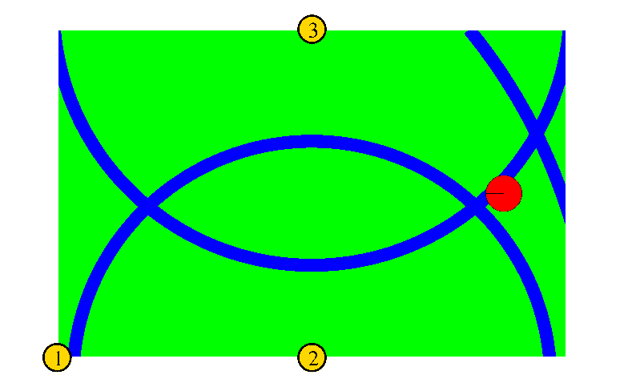


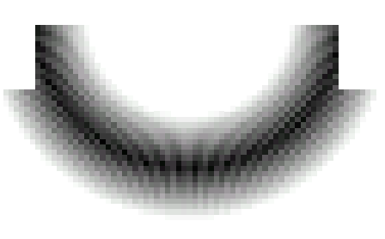

Distributions

Slide 37
Distributions
Wanted: samples distributed according to p(x| z₁, z₂, z₃)

Slide 38
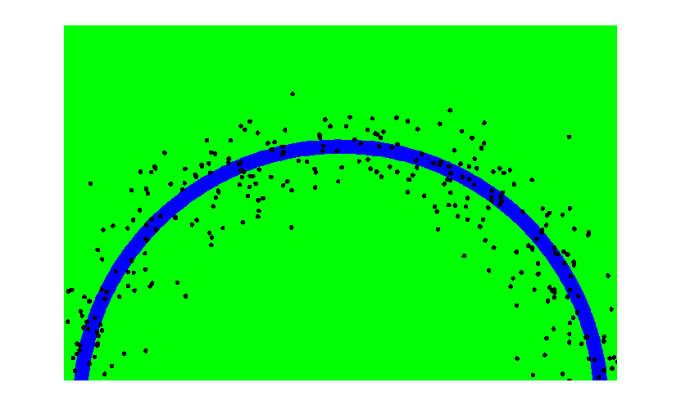
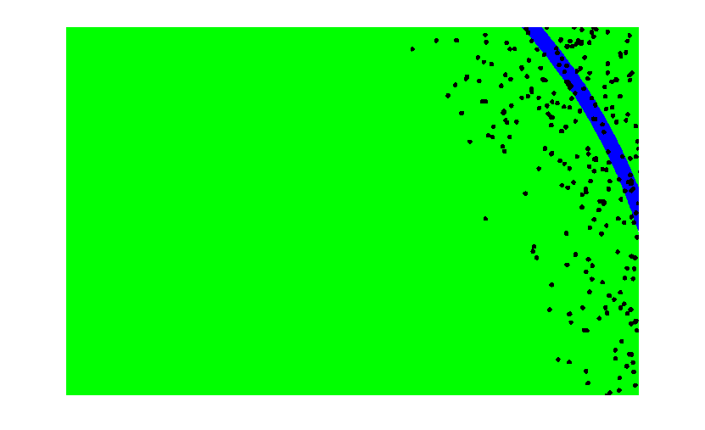
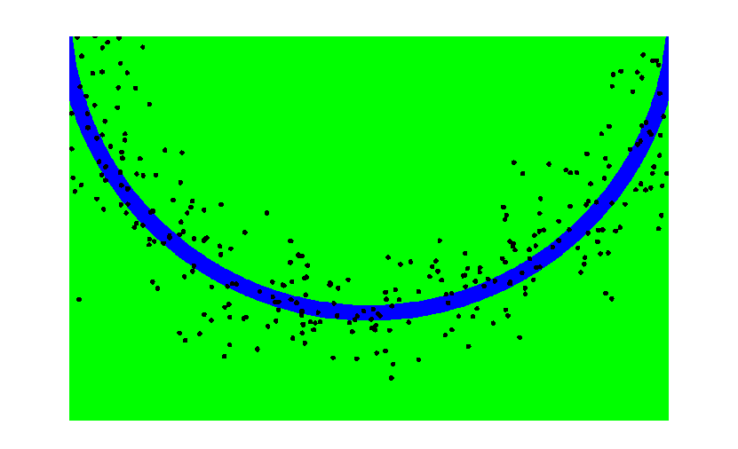
This is Easy!
We can draw samples from p(x|z_{l}) by adding noise to the detection parameters.

Slide 39
Importance Sampling with Resampling

Slide 40
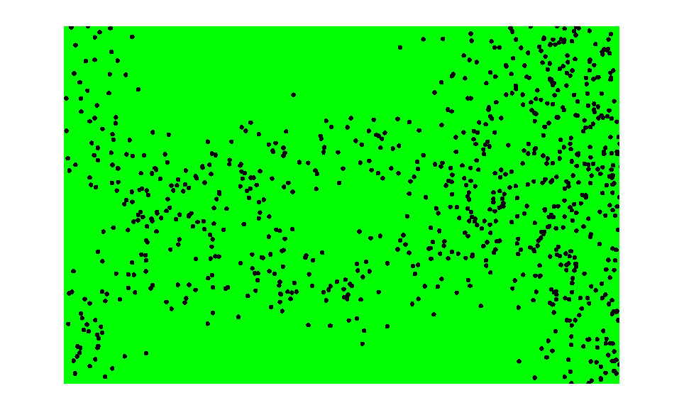

Importance Sampling with Resampling
Weighted samples
After resampling

Slide 41
For particle filter
f
bel(x_{t} ) target distribution
g
bel(x_{t-1} )p(x_{t}|u_{t},x_{t-1}) proposal distribution
Weights?

Slide 42

Sampling (State transition)
Important weights?
Resampling

Slide 43

Particle Filters

Slide 44


Sensor Information: Importance Sampling

Slide 45


Robot Motion

Slide 46

Sensor Information: Importance Sampling

Slide 47


Robot Motion

Slide 48
Particle Filter Algorithm
draw x^{i}_{t−1} from Bel(x_{t−1})
draw x^{i}_{t} from p(x_{t} | x^{i}_{t−1},u_{t−1})
Importance factor for x^{i}_{t}:

Slide 49
Resampling
Given: Set S of weighted samples.
Wanted : Random sample, where the probability of drawing x_{i} is given by w_{i}.
Typically done M times with replacement to generate new sample set S’.

Slide 50
Resampling
w_{n}
w₁
w_{n}
w₁
w₂
w₂
W_{n-1}
W_{n-1}
w₃
w₃
Roulette wheel
Binary search, n log n

Slide 51

Sample-based Localization (sonar)

Slide 52

Localization for AIBO robots

Slide 53
Practical Considerations and Properties
Density Extraction
Sampling Variance
Resampling
Sampling Bias
Particle Deprivation

Slide 54
Density Extraction
Samples
Continuous estimate
Gaussian approximation
Multimodel
Kernel density

Slide 55





Slide 56
Practical Considerations and Properties
Density Extraction
Sampling Variance
Particle is finite: estimate error

Slide 57
Practical Considerations and Properties
Density Extraction
Sampling Variance
Resampling
Sampling Variance is amplified through repetitive resampling
Even though the variance of the particle set itself decreases
the variance of the particle set as an estimator
of the true belief increases

Slide 58

Strategies:
Reduce resampling frequency
When resampling?
Low variance sampling
Stratified Sampling

Slide 59


Low variance sampling
Stochastic universal sampling: samples dependent
Systematic resampling
Linear time complexity
Easy to implement, low variance

Slide 60
Practical Considerations and Properties
Density Extraction
Sampling Variance
Resampling
Sampling Bias
Example: Only one particle
Reason: Normalization of weights
Solution: Increase the particle number

Slide 61
Practical Considerations and Properties
Density Extraction
Sampling Variance
Resampling
Sampling Bias
Particle Deprivation:
loss track of the true state: add a small number of randomly generated particles

Slide 62
Practical Considerations
Dealing with highly peaked observations
Add noise to observation model
Better proposal distributions: e.g., perform Kalman filter step to determine proposal
Recover from failure by selectively adding samples from observations
Overestimating noise often reduces number of required samples
Resample only when necessary (efficiency of representation measured by variance of weights)
Try to avoid sampling whenever possible!

Slide 63
Important Books
1. 《Bayesian Forecasting and Dynamic Models》West and Harrison
2. 《Sequential Monte Carlo Methods in Practice》Doucet

Slide 64
Homework
Page 116, Exercises 5

